Slide 1
Representing Relations
Matrix review
Two ways to represent relations
  Via matrices
  Via directed graphs

Slide 2
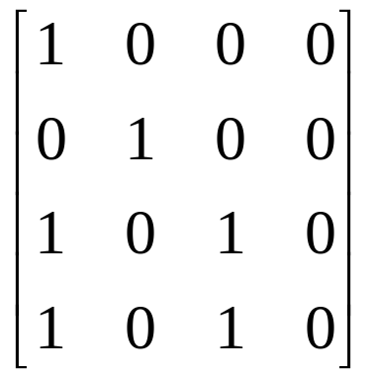
Matrix review
We will only be dealing with zero-one matrices
  Each element in the matrix is either a 0 or a 1
These matrices will be used for Boolean operations
  1 is true, 0 is false

Slide 3

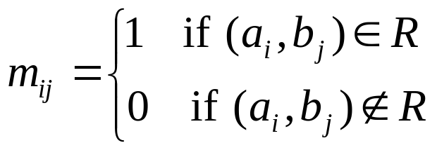
Relations using matrices
List the elements of sets A and B in a particular order
  Order doesn’t matter, but we’ll generally use ascending order
Create a matrix

Slide 4
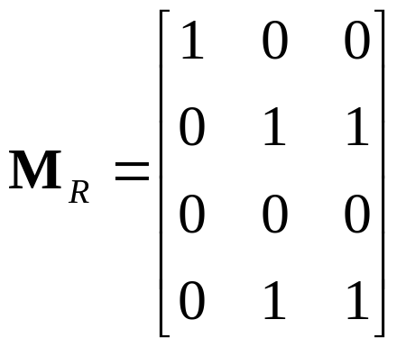
Relations using matrices
Consider the relation of who is enrolled in which class
  Let A = { Alice, Bob, Claire, Dan }
  Let B = { CS101, CS201, CS202 }
  R = { (a,b) | person a is enrolled in course b }
 | CS101 | CS201 | CS202
Alice | X
Bob |  | X | X
Claire
Dan |  | X | X

Slide 5
Relations using matrices
What is it good for?
  It is how computers view relations
    A 2-dimensional array
  Very easy to view relationship properties
We will generally consider relations on a single set
  In other words, the domain and co-domain are the same set
  And the matrix is square

Slide 6
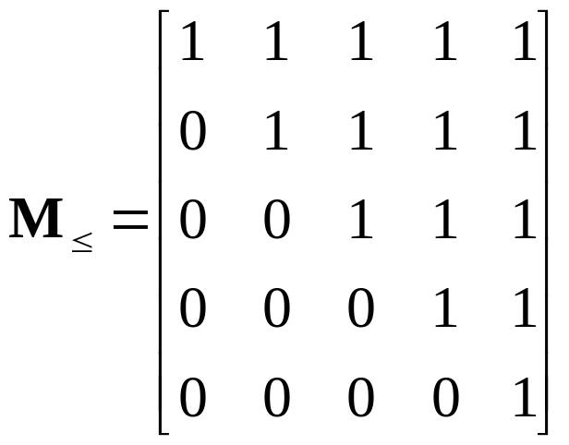
Reflexivity
Consider a reflexive relation: ≤
  One which every element is related to itself
  Let A = { 1, 2, 3, 4, 5 }
If the center (main) diagonal is all 1’s, a relation is reflexive

Slide 7
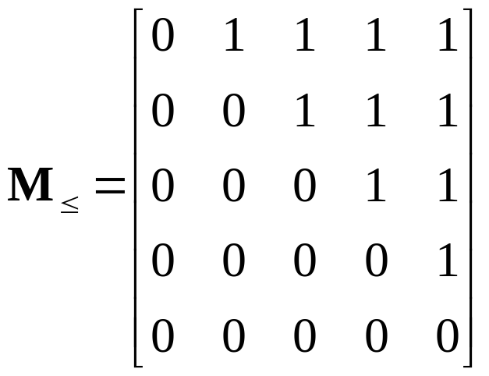
Irreflexivity
Consider a reflexive relation: <
  One which every element is not related to itself
  Let A = { 1, 2, 3, 4, 5 }
If the center (main) diagonal is all 0’s, a relation is irreflexive

Slide 8
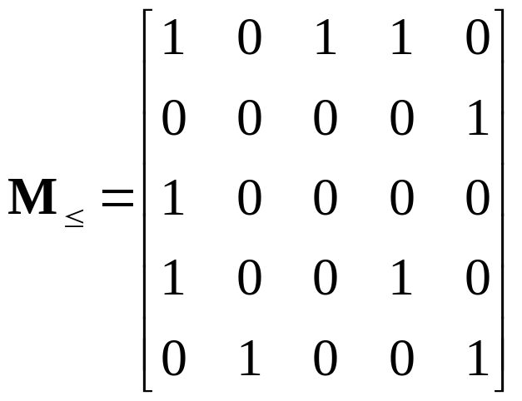
Symmetry
Consider an symmetric relation R
  One which if a is related to b then b is related to a for all (a,b)
  Let A = { 1, 2, 3, 4, 5 }
If, for every value, it is the equal to the value in its transposed position, then the relation is symmetric

Slide 9
Antisymmetry
Consider an antisymmetric relation: ≤
  One which if a is related to b then b is not related to a unless a=b for all (a,b)
  Let A = { 1, 2, 3, 4, 5 }
If, for every value and the value in its transposed position, if they are not both 1, then the relation is antisymmetric
The center diagonal can have both 1’s and 0’s

Slide 10
Transitivity
Consider an transitive relation: ≤
  One which if a is related to b and b is related to c then a is related to c for all (a,b), (b,c) and (a,c)
  Let A = { 1, 2, 3, 4, 5 }
If, for every spot (a,b) and (b,c) that each have a 1, there is a 1 at (a,c), then the relation is transitive
Matrices don’t show this property easily

Slide 11
Representing relations using directed graphs
A directed graph consists of:
  A set V of vertices (or nodes)
  A set E of edges (or arcs)
  If (a, b) is in the relation, then there is an arrow from a to b
Will generally use relations on a single set
Consider our relation R = { (a,b) | a divides b }
Old way:
1
2
3
4
1
2
3
4
1
2
3
4

Slide 12
Reflexivity
Consider a reflexive relation: ≤
  One which every element is related to itself
  Let A = { 1, 2, 3, 4, 5 }
1
2
If every node has a loop, a relation is reflexive
5
3
4

Slide 13
Irreflexivity
Consider a reflexive relation: <
  One which every element is not related to itself
  Let A = { 1, 2, 3, 4, 5 }
1
2
If every node does not have a loop, a relation is irreflexive
5
3
4

Slide 14
Symmetry
Consider an symmetric relation R
  One which if a is related to b then b is related to a for all (a,b)
  Let A = { 1, 2, 3, 4, 5 }
If, for every edge, there is an edge in the other direction, then the relation is symmetric
Loops are allowed, and do not need edges in the “other” direction
1
2
Called anti-
parallel pairs
5
3
4
Note that this relation is neither reflexive nor irreflexive!

Slide 15
Asymmetry
Consider an asymmetric relation: <
  One which if a is related to b then b is not related to a for all (a,b)
  Let A = { 1, 2, 3, 4, 5 }
A digraph is asymmetric if:
If, for every edge, there is not an edge in the other direction, then the relation is asymmetric
Loops are not allowed in an asymmetric digraph (recall it must be irreflexive)
1
2
5
3
4

Slide 16
Antisymmetry
Consider an antisymmetric relation: ≤
  One which if a is related to b then b is not related to a unless a=b for all (a,b)
  Let A = { 1, 2, 3, 4, 5 }
If, for every edge, there is not an edge in the other direction, then the relation is antisymmetric
Loops are allowed in the digraph
1
2
5
3
4

Slide 17
Transitivity
Consider an transitive relation: ≤
  One which if a is related to b and b is related to c then a is related to c for all (a,b), (b,c) and (a,c)
  Let A = { 1, 2, 3, 4, 5 }
A digraph is transitive if, for there is a edge from a to c when there is a edge from a to b and from b to c
1
2
5
3
4

Slide 18
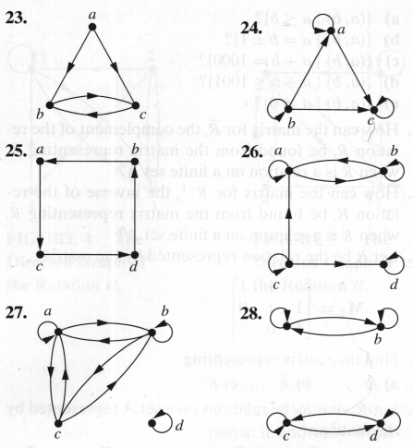
Sample questions
Which of the graphs are reflexive, irreflexive, symmetric, asymmetric, antisymmetric, or transitive
 | 23 | 24 | 25 | 26 | 27 | 28
Reflexive |  | Y |  | Y |  | Y
Irreflexive | Y |  | Y
Symmetric |  |  |  |  | Y | Y
Asymmetric |  |  | Y
Anti-symmetric |  | Y | Y
Transitive |  |  |  |  |  | Y

